Slide 1






HOSPITAL MANAGEMENT SYSTEM
Developed By: Manav Khadka
Course: B.Tech. CSE
Scholar NO.:1501-21-115
Enrollment No.:LNCBBTCSE063

Slide 2
Introduction
It is software which can run in both OS window as well as Linux
It is Hospital Management software which provide a facility to Manage Patient’s, Doctor’s, Staff’s, detail
From this software hospital can increase their speed , productivity, and accountability
It Provide GUI which contain button for Save, Update, Delete data from database
By this software we can see patient data in table and the data is storing on data base

Slide 3
Start
Login
Fig(a): Data Flow Diagram
False
If Username and Password is correct
True
Choices
Admin will select a choice and according to that operation performed
False
If choice==close application
True
End

Slide 4
Login
Select management system
Patients management
Doctors management
Staff’s management
Here Admin can add patient detail and with the help of Save button, and can update, select, data with the help of button. And when admin click on exit it will terminate.
It will update to next version
It will update to next version
Fig(b): User Flow Diagram

Slide 5



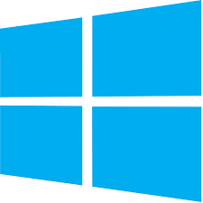
System Requirements
For window
System Requirements
For Linux
Operating System: Windows XP/Vista/7/8/8.1/10/11
RAM: 512MB
Hard Disk: 20 MB
Processor: Intel Dual Core or higher processor
Operating System: Debian Based Linux distro: Ubuntu ,etc.
RAM: 512MB
Hard Disk: 20 MB
Processor: Intel Dual Core or higher processor
Technology Used
Python 3.10,MySQL workbench/Server
Python Module “tkinter”(For GUI) && “MySQL connector”(Connecting to my database)
Future Enhancement:-
-->Doctor Management System
-->Staff Management System
-->Search Option for database
-->Back button

Slide 6
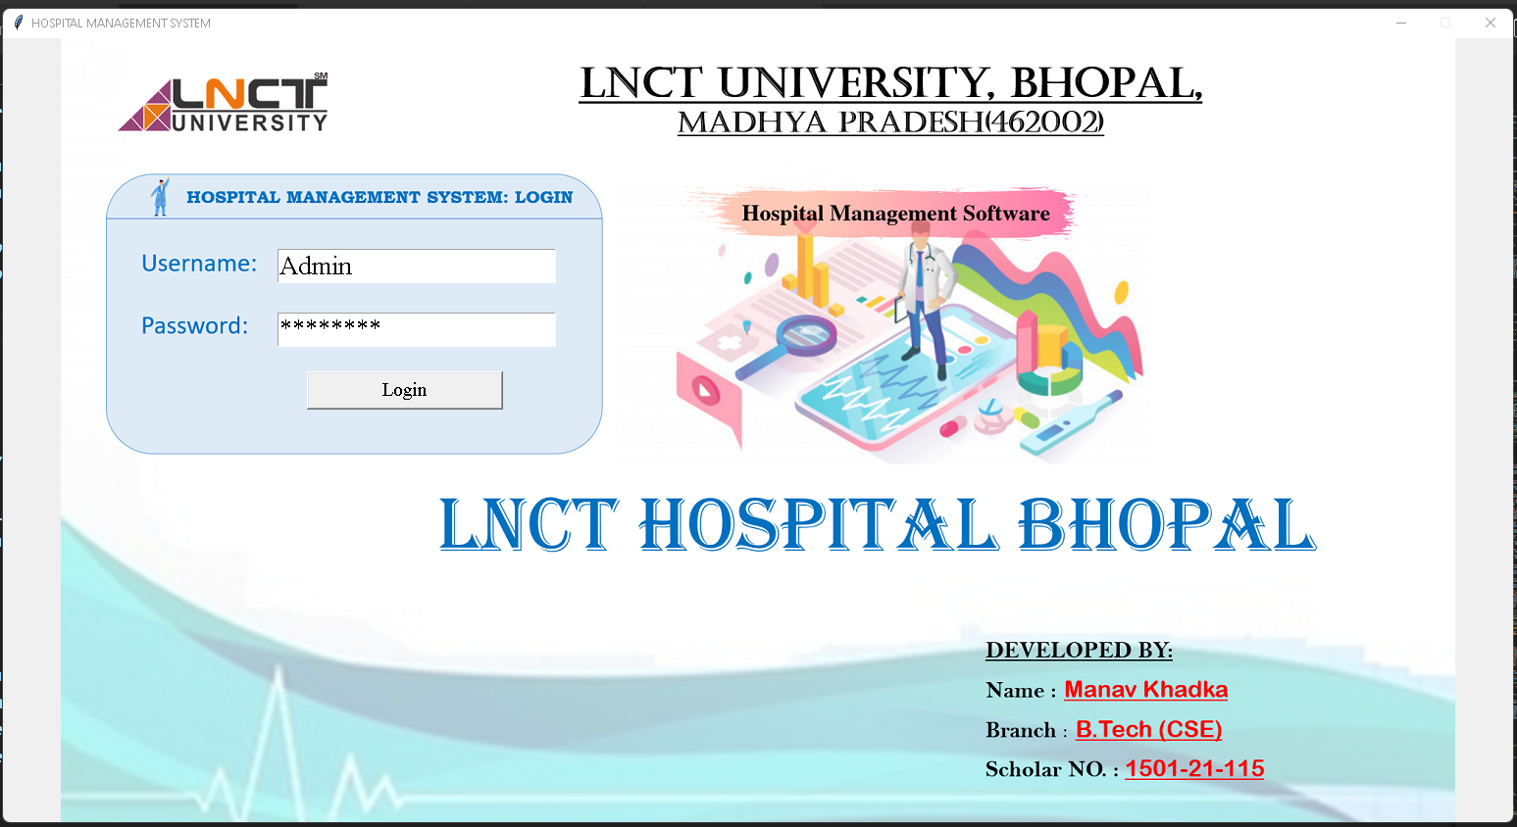

Output First

Slide 7
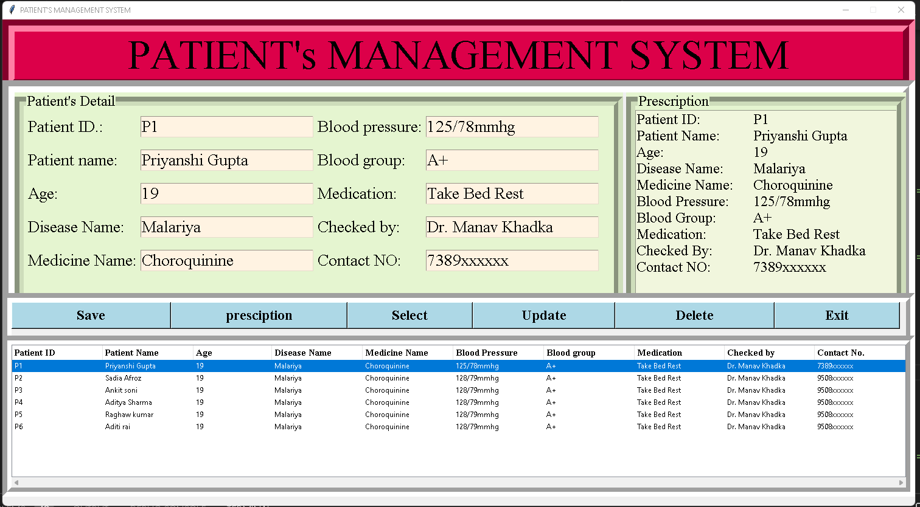
Output Second

Slide 8
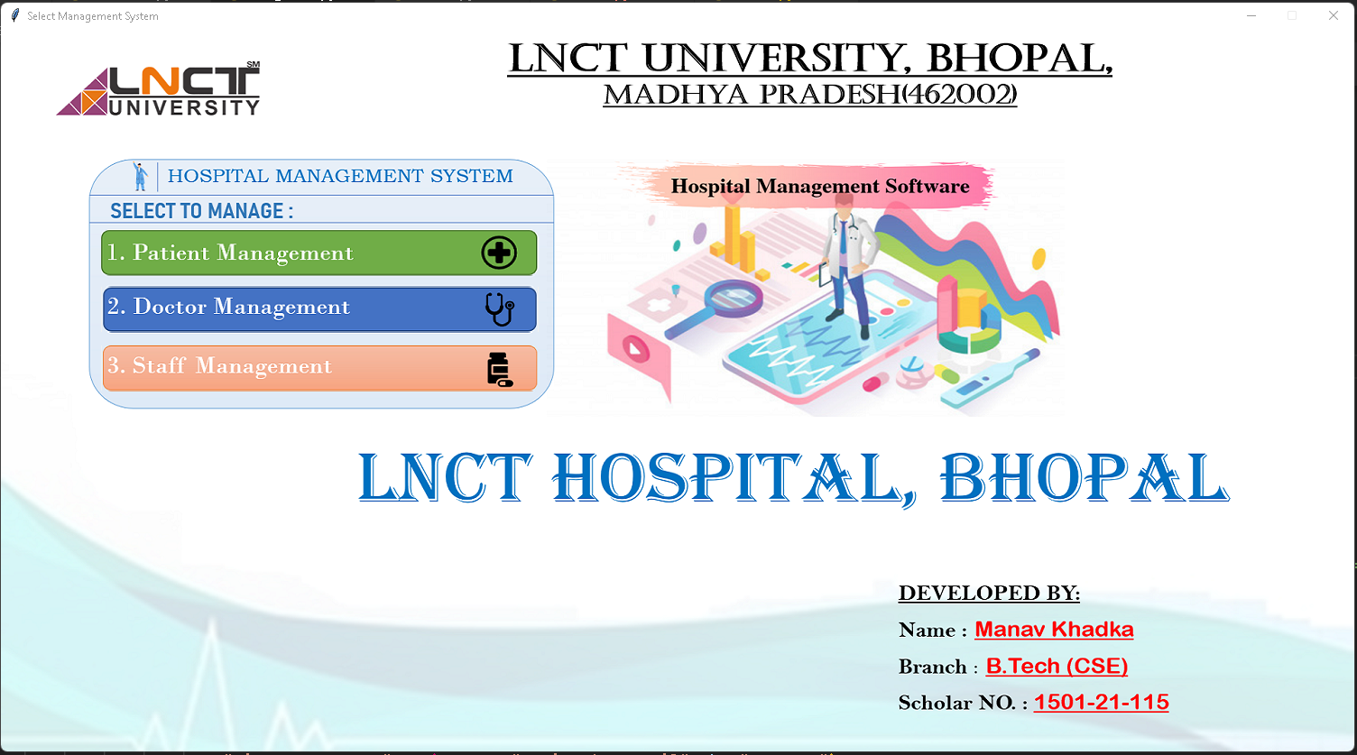
Output Third

Slide 9
Conclusion:-
This is Computerized Hospital Management system which include patient’s , Doctors , and Staff management.
It is a clean and easy interface software
It is beneficial because it saved paper work, time and also improved accuracy.
We can access data base to see patients records
Thank you!!

